Slide 1
Supportlytics
Data-Driven Optimization of IT Support Team Performance Using Advanced Analytics
INFOSYS SPRINGBOARD
MILESTONE 1 REVIEW
Presented by
Uma Parvathi Devi Nakireddy

Slide 2
Project Overview
Turning IT Support Data into Actionable Intelligence
Supportlytics is designed to analyze IT support ticket data in a structured way. Instead of looking at individual tickets, the project focuses on understanding overall support performance by organizing the data, creating meaningful features, and preparing it for detailed analysis and dashboard development. This helps convert raw operational data into valuable insights for decision-making
Project Objective
Analyze IT support ticket data to measure team performance, identify recurring issues, and prepare structured data for advanced dashboard development.

Slide 3
Project Objectives
Key Goals for Milestone 1
Analyze Ticket Data
Understand Team Performance
Examine IT support ticket records to understand data structure and content.
Evaluate support team efficiency through ticket assignment and resolution metrics.
Measure Resolution Efficiency
Identify Recurring Issues
Track how quickly and effectively tickets are resolved across categories.
Spot patterns and frequent problem types to inform proactive solutions.
Prepare for Dashboard Development
Generate Business Insights
Clean and structure data to enable future Power BI dashboard creation.
Transform raw ticket data into meaningful, decision-ready analytics.

Slide 4
Dataset Overview
20,000 Records of IT Support Intelligence
Dataset Summary
20K
0
Total Records
Missing Values
The dataset contains comprehensive IT support ticket information, verified for completeness and quality. After thorough validation, no missing values were found across any field.
Ticket Details
Resolution Info
Customer Info
Priority, Status, Category
Assigned Team, Resolution Date
Country, Customer Details

Slide 5





Technology Stack
Tools Powering the Analysis
Python
Pandas
Microsoft Excel
Core programming language for data processing and analysis.
Data manipulation library for cleaning and transformation.
Initial data inspection and supplementary documentation.
Power BI
VS Code
Planned for dashboard development in the upcoming phase.
Code editor used for writing, debugging, and managing project file

Slide 6

Work Completed — Module 1
Data Exploration & Validation Workflow
Load Dataset
Explore Schema
Validate Quality
Analyze Distribution
Each step was completed sequentially to ensure a thorough understanding of the dataset before advancing to feature engineering and analysis.

Slide 7
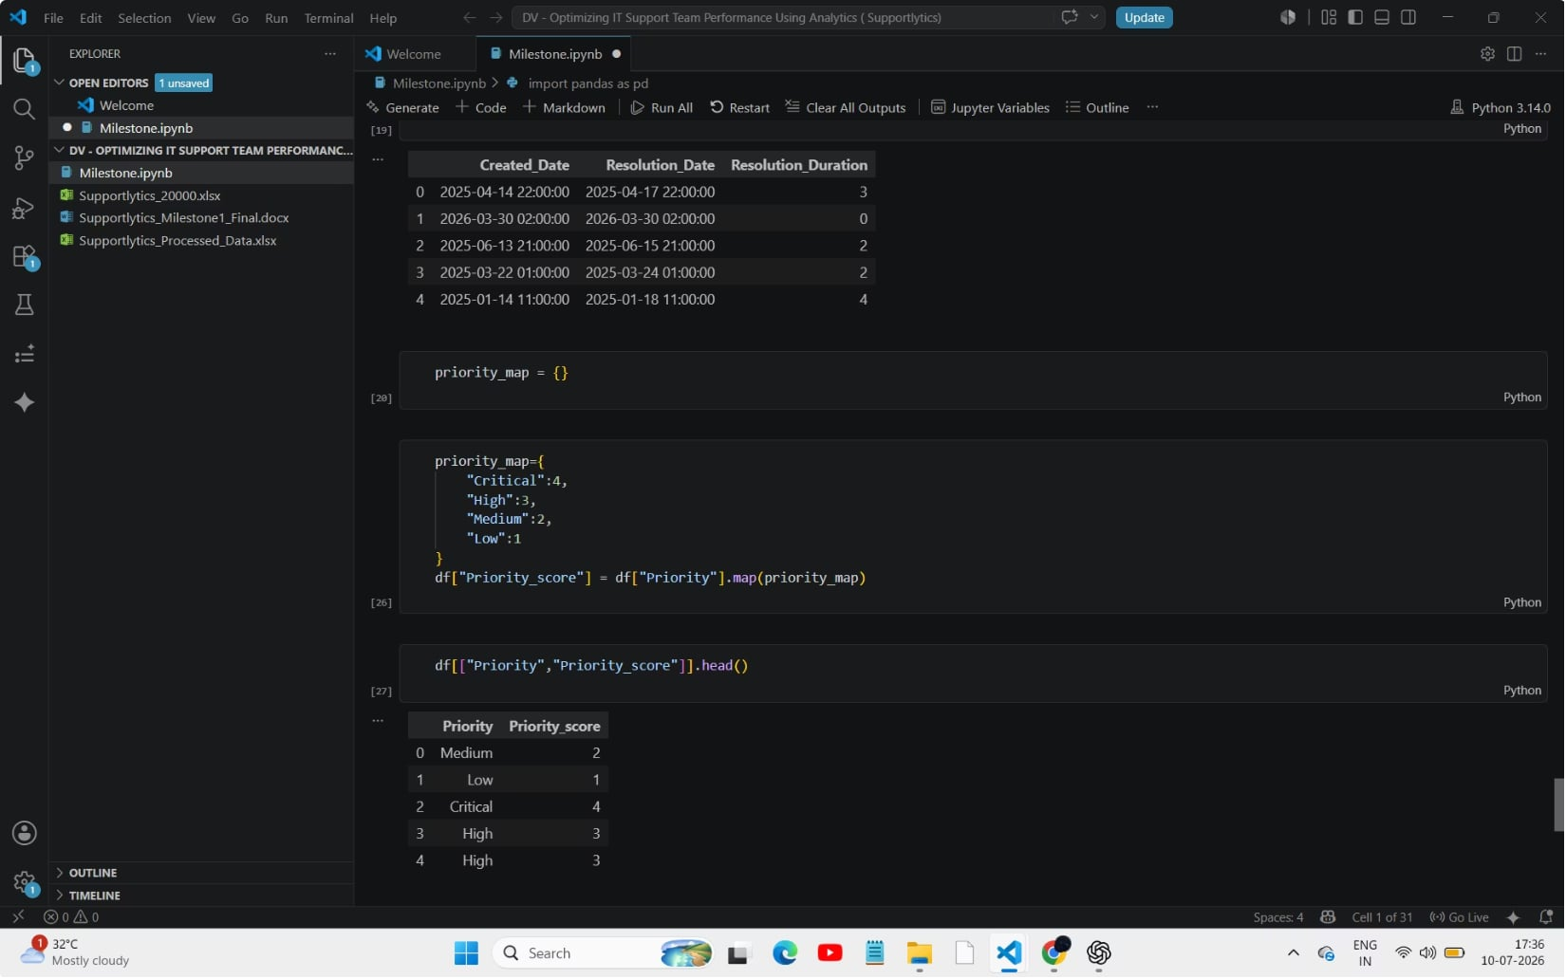
Work Completed — Module 2
Feature Engineering: Adding Analytical Depth
These features were created to transform raw dates and categorical labels into measurable metrics, enabling deeper analysis of team performance and ticket handling efficiency in the next phase.
1
2
Resolution_Duration
Priority_Score
Numerical mapping of priority levels — Critical (4), High (3), Medium (2), Low (1) — to enable quantitative analysis.
Calculated using Created_Date and Resolution_Date to measure the exact time taken to resolve each ticket.

Slide 8
Deliverables Completed
Milestone 1 Outputs
Cleaned Dataset
Feature Engineering Summary
Verified and quality-checked raw data
Documentation of new analytical features
Data Dictionary
Processed Dataset
Complete field definitions and descriptions
Analysis-ready dataset with new features

Slide 9
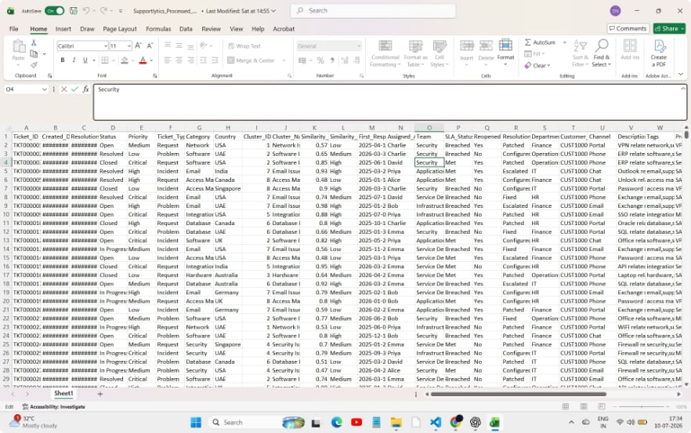
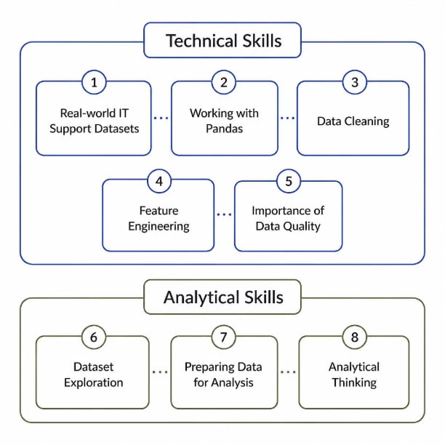

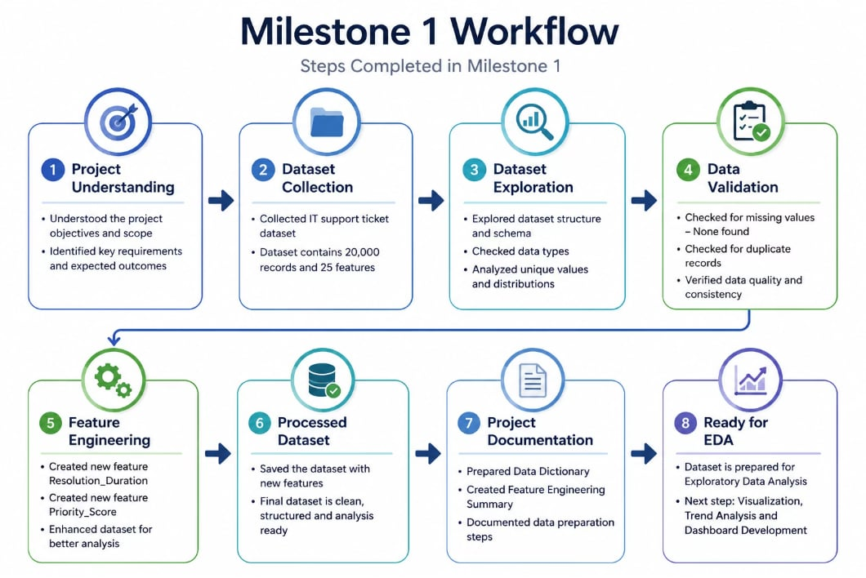
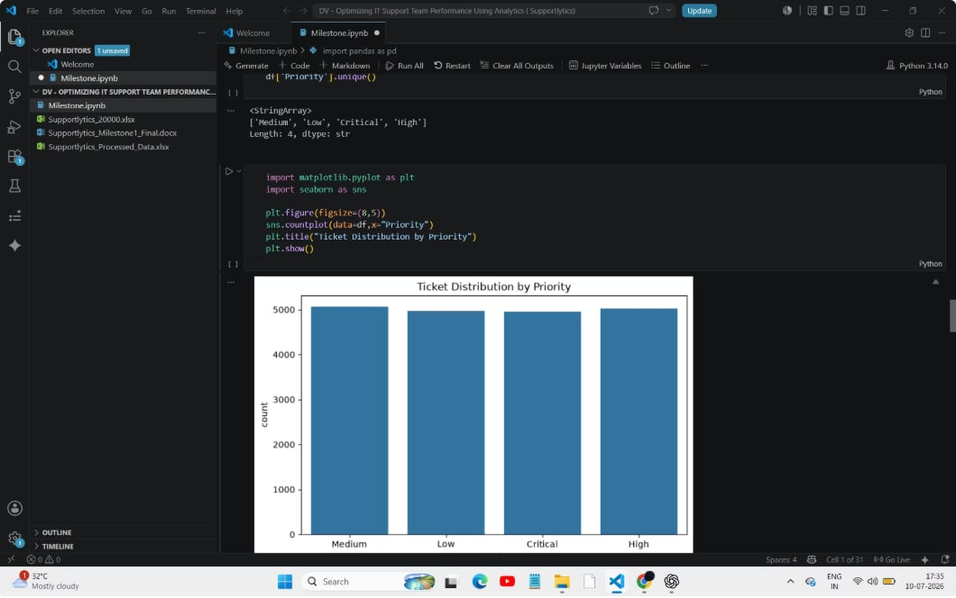
Key Learnings
Insights Gained During Milestone 1

Slide 10
Challenges & Solutions
Overcoming Obstacles Through Structured Problem-Solving
Understanding Dataset Structure
Feature Engineering Implementation
Working with Large Datasets
Challenge: Initial complexity in navigating 20,000 records across multiple fields.
Solution: Explored schema and data types systematically to map the full structure.
Challenge: Determining which features would add the most analytical value.
Solution: Created Resolution_Duration and Priority_Score based on business requirements.
Challenge: Ensuring data integrity across a high-volume dataset.
Solution: Performed thorough data validation before proceeding to analysis.

Slide 11

THANK YOU….!

